Slide 1


Positive self-reference during Interview
COMPUTER SCIENCE DEPARTMENT
Name-Vaishali
Course-MSc 1st Sem
SUBJECT – CS-401 COMMUNICATION SKILL
ROLL NO. – 23419CMP029

Slide 2
Why it is important:-
Positive self-reference during a job interview is essential. No one wants to hire someone that seems to be measurable or unsure about their skills .Employers want to hire people that appear upbeat and likely to get along with their bosses ,co-workers and clients. Even if you are well qualified for a position, but your negative attitude can hurt your chances of getting the job, if you freeze during an interview. So at that time, there are some tips, that will help you to stay positive.

Slide 3

Think positive
If you go into an interview and think that you won't get the job or that you will not get higher will be measurable. It will be hard for you to convince the employer.
Hopefully once you are involved in a conversation with your interviewer. You will hit your stride and answer the questions with confidence .
This Photo by Unknown Author is licensed under CC BY-SA-NC

Slide 4
Grooming
When you look good you feel good, keep this in mind when selecting your interview outfit. knowing you look your best may improve how you feel .
SMILE AND BE FRIENDLY
smile, even when you are not feeling happy can actually brighten your mode.
So even if you are feeling bad , go out of the office with a smile, it will put you and as well as interviewer in a good mode.

Slide 5
Sit-up straight
Your posture can make you look negative. Posture is important nonverbal form of communication that conveys how you feel about yourself. Seriously sit up straight and face the interview with your shoulders back. Look the interview in the eye and never mumble. If you avoid eye contact or turn your body away from the interviewer. You may come across as pathetic or lacking in confidence . instead sit straight with your shoulders back and looked at the employer eye, I think this poster will make you appear confident even before you say a word.

Slide 6
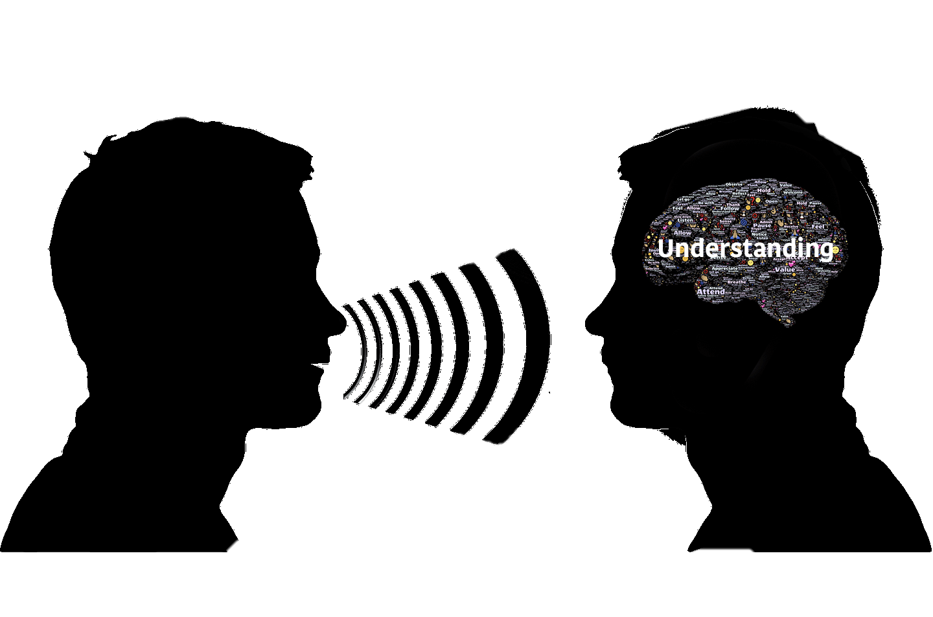
active listening
Practice active listening to make sure you stay focused on the interviewer and understand what he is saying .look in the eye of interviewee, while she is taking half clarifying question and rephrase what she says to ensure your understanding. Active listening demonstrate that you are engaged and interested in the job.

Slide 7
convey a can-do attitude→
Even if you feel like you are not a perfect fit for a job, you do not want to emphasize that during the interview before the interview draw a list of qualities and experiences that relate to the job requirements as stated in the job listing this way if the interviewer ask why you are a good fit for the job, you have a number of reasons and examples and even if the interviewer asks if you have experience with the top of which you know nothing. Admit your lack of experience, but also show your interest and enthusiasm in learning something new, while having the skills necessary for a job is important, a positive can-do attitude goes a long way.

Slide 8
practice
What you will say, you should prepare before the interview so that you will know exactly what to do or say when they asked the questions.
Ask you friend to come over and practice with him using a set of questions.
You have device you can work yourself to some of the most asked questions.

Slide 9
THANK YOU!

